Slide 1
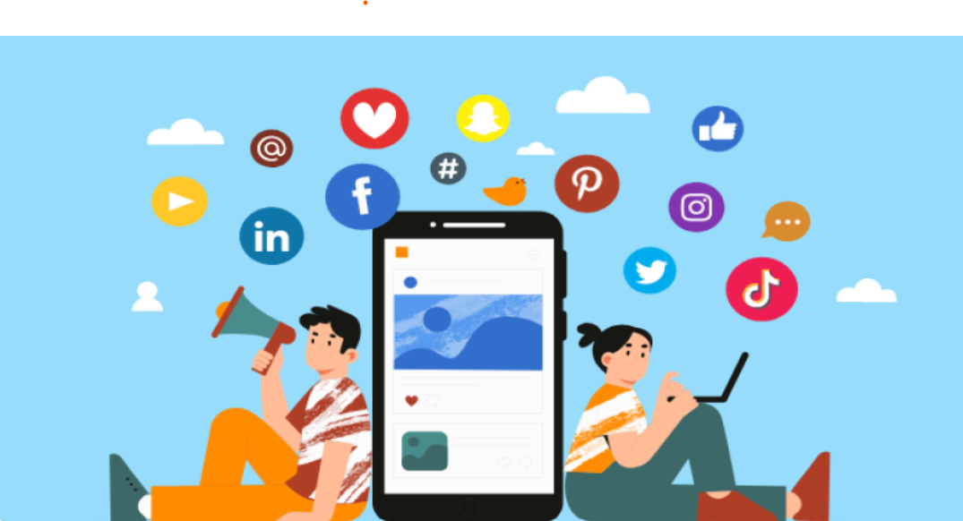
Media Applications
Microsoft Planetary Computer
211FA04198
211FA04528

Slide 2
Cloud Interaction:
Storage : Utilizes cloud storage (e.g., Amazon S3, Google Cloud Storage) for scalable media file management.
Content Delivery: Leverages CDNs (e.g., CloudFront) for fast media delivery.
Streaming Services: Uses cloud streaming solutions (e.g., AWS Elemental, Azure Media Services) for live/on-demand content.
Processing: Employs serverless processing (e.g., AWS Lambda) for media file transcoding.
Domain Considerations:
Domain Management: Uses cloud DNS services (e.g., AWS Route 53) for reliable domain access.
Security: Utilizes cloud security services (e.g., AWS Shield) to protect user data and ensure compliance.
Application Interaction:
Microservices Architecture: Enables development and scaling of app functionalities.
API Integration: Interacts with cloud services via APIs (e.g., AWS API Gateway).
User Management: Implements cloud identity services (e.g., AWS Cognito) for secure access.
Services Provided by the Cloud : independent
Database Services: Managed databases (e.g., Amazon RDS) for metadata and user data storage.
Machine Learning: Integrates ML services (e.g., AWS Rekognition) for content analysis and recommendations.
Analytics: Uses analytics tools (e.g., Google Analytics) for performance tracking and insights.

Slide 3
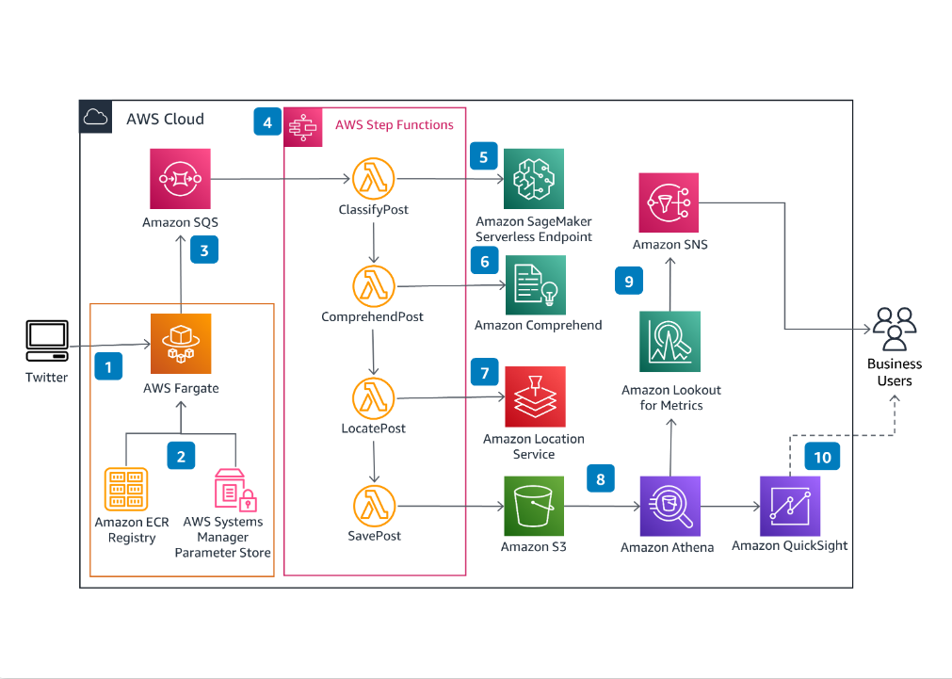
Source: https://aws.amazon.com/solutions/guidance/social-media-insights-on-aws/

Slide 4
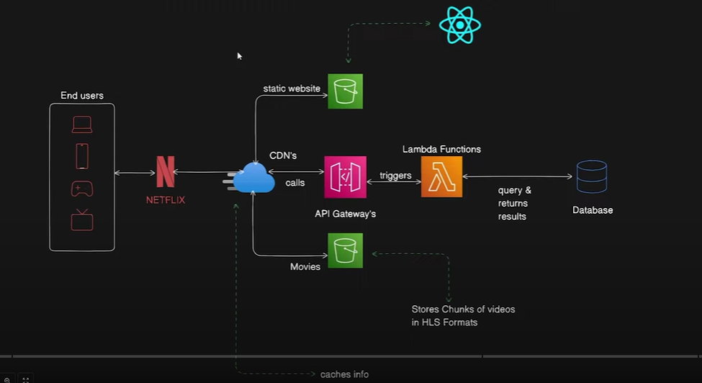
Source: https://youtu.be/xnLwtVmW8Sk?si=s5AFxpHlr-7tnl9B

Slide 5


